Slide 1
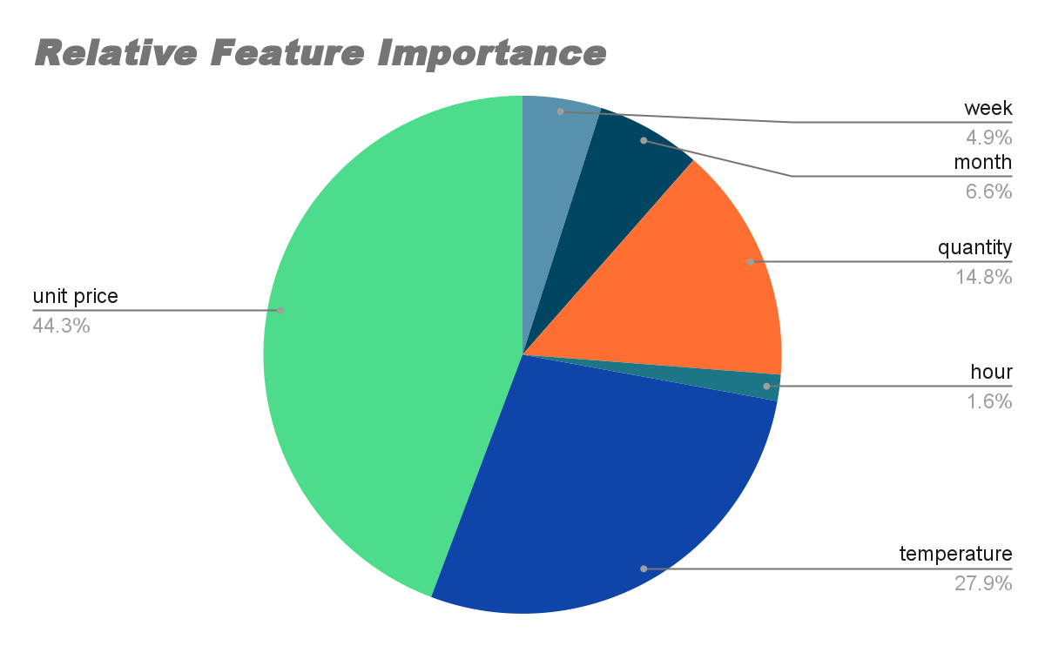
Key Findings from Data Modelling
Product Categories:
Product categories were found to have less importance in predicting stock levels.
While product categories contribute to overall stock management, other factors play a more critical role.
Unit Price and Temperature:
Unit price and temperature data were identified as significant predictors of stock levels.
Higher unit prices and extreme temperature fluctuations can influence stock demands.
Hour of Day:
The hour of the day was found to be important for predicting stock levels.
Different hours may experience varying customer footfall and demand patterns.
Notes:
Entered text
Product Categories:
Product categories were found to have less importance in predicting stock levels.
While product categories contribute to overall stock management, other factors play a more critical role.
Unit Price and Temperature:
Unit price and temperature data were identified as significant predictors of stock levels.
Higher unit prices and extreme temperature fluctuations can influence stock demands.
Hour of Day:
The hour of the day was found to be important for predicting stock levels.
Different hours may experience varying customer footfall and demand patterns.
Entered text
Product Categories:
Product categories were found to have less importance in predicting stock levels.
While product categories contribute to overall stock management, other factors play a more critical role.
Unit Price and Temperature:
Unit price and temperature data were identified as significant predictors of stock levels.
Higher unit prices and extreme temperature fluctuations can influence stock demands.
Hour of Day:
The hour of the day was found to be important for predicting stock levels.
Different hours may experience varying customer footfall and demand patterns.

